Slide 1
Making a cup of tea
basic programming skills workshop
by Luke Butcher
Notes:
So everyone here is looking to write some kind of software to do this we use languages library IDEs and a whole host of other tools and resources, however before we start we really only need to develop a 2 skills 1) Analysing a problem
All of software is tools to solve problems and all of software development is creating tools to solve problems we need to be able to break down a problem into a set of distinct tasks and then make each one.
2) patience
Your code is not gonna work first time, probably. You will need to be patient and keep debugging and refining
That's it everything else is optional and problem specific, knowing java, python, c,, c++, is ofc useful you will need a language but you can learn that as you go. So if you are sitting here now and have never seen any code before thats fine if you have been coding for years thats fine too ill have jobs for you through out this

Slide 2
Set up
Run IDE, pyzo
pyzo.org/start.html
print(“hello world”)
Notes:
So before we begin breaking down some problems lets get set up and write some code
If you have a university machine open apps anywhere start and search for pyzo
If you have your own machine go to https://pyzo.org/start.html and follow the instructions
Once you have the environment set up write a simple hello world

Slide 3

You are all now programmers you have created and ran your first ( or Nth) program !

Slide 4
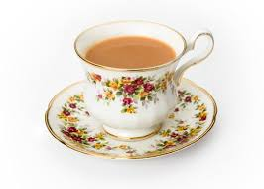
The problem: I want tea
Notes:
Right so now we have some code and we have an environment here's a problem for you to solve Not all problems are this simple but this one is good for demonstration.
So what are the steps for making tea ?

Slide 5
How do we make tea?
boil water
put tea in a pot
when the water is boiled pour it into the pot
wait 5 mins
pour the tea into cups
add milk
drink
Notes:
So we can see this breaks down from “ make tea” in to a bunch of steps. We can get more out of this though

Slide 6
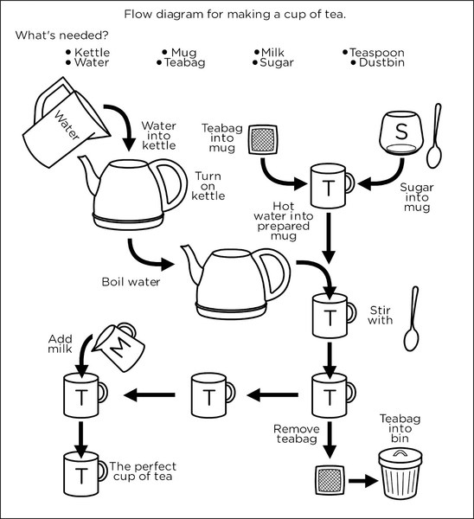
bit.ly/
2Vq
XzsA
Notes:
Now we have a bunch of steps with branching paths and we have a list of resources. So im not gonna bore you anymore with tea lets do some coding
You have 20 minutes start making some tea in python there's an example at the link
Everyone that doesn't have a laptop look to the person next to you every one that does be say hi and code with them

Slide 7
So lets review
Readability
Variable names
Function names
Structure
Flow control
Choice
Function
Does it do the job?
Does it do the job well?
Notes:
From the code you can see that the variable and function names arent good the variable names arent good that good There's no error checking to see if we have the resources required
There's no facility for the user to make a choice do they want milk? do they want sugar ?

Slide 8
The better version
bit.ly/2M0pVa4
Notes:
Download from here, this is unfinished you can see the commented out section is from the first version, go ahead and finish it off!

Slide 9
Think you can improve on this code?
Luke.butcher@port.ac.uk
V1 bit.ly/2VqXzsA
Make it worse more bad variables, add redundancy write it like zero code reuse.
V2 bit.ly/2M0pVa4
Objective make its cleaner and easier to read remove redundancy. Make it gooderah

